Slide 1
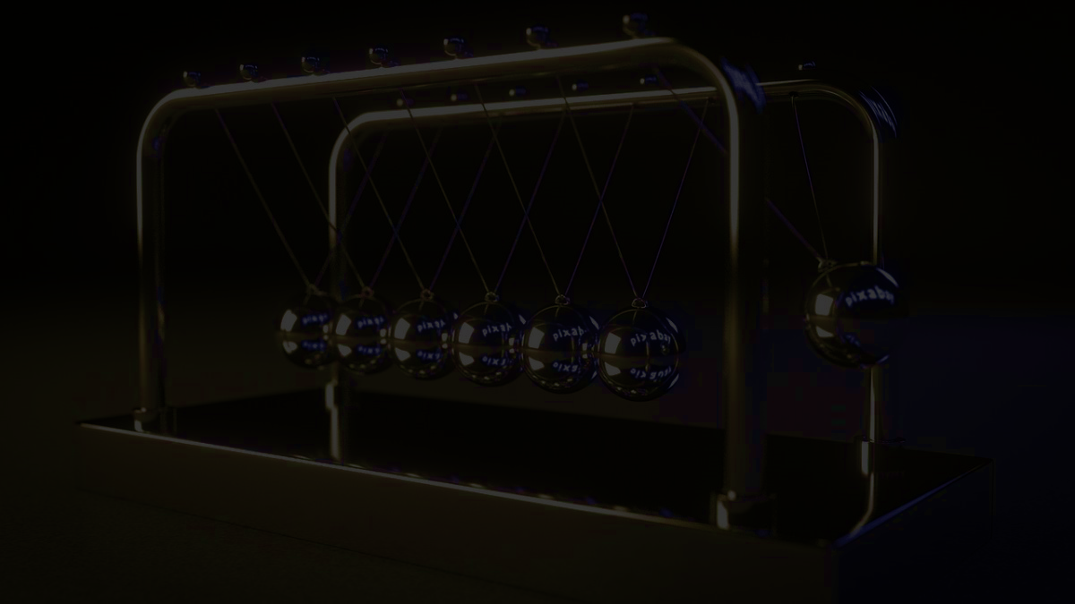
PhysiPlay
A revolutionary 2D physics simulator
Team GapeHorn123: Raiven Simbajon, Sunny Chen, Kevin Deng, Vinith Kanagaratram

Slide 2
Concept aspects
Problems Addressed
Limited Flexibility
Most tools use hardcoded setups with few adjustable options
Difficulty in Prototyping
Testing ideas requires heavy coding or expensive software
Disconnect Between Theory and Practice
Abstract models lack hands-on, visual experimentation

Slide 3

Concept aspects
Solutions Provided by the Application
Fully Customizable Sandbox
Adjust every element—from object properties to environmental factors
Real-Time Visual Feedback
Instant updates as parameters change
Rapid Prototyping
Quickly test ideas
User-Friendly Interface
Intuitive drag-and-drop tools for easy scene creation
Bridging Theory & Practice
Direct interaction with abstract physics concepts

Slide 4

Concept aspects
Fully Customizable Interactive Simulation Sandbox – combines approaches of:
Educational Tools
Users create and modify their own experiments
Rapid Prototyping
Lightweight, accessible platform versus complex engineering software
Interactive Environment
Fully adjustable settings replace static or fixed setups

Slide 5
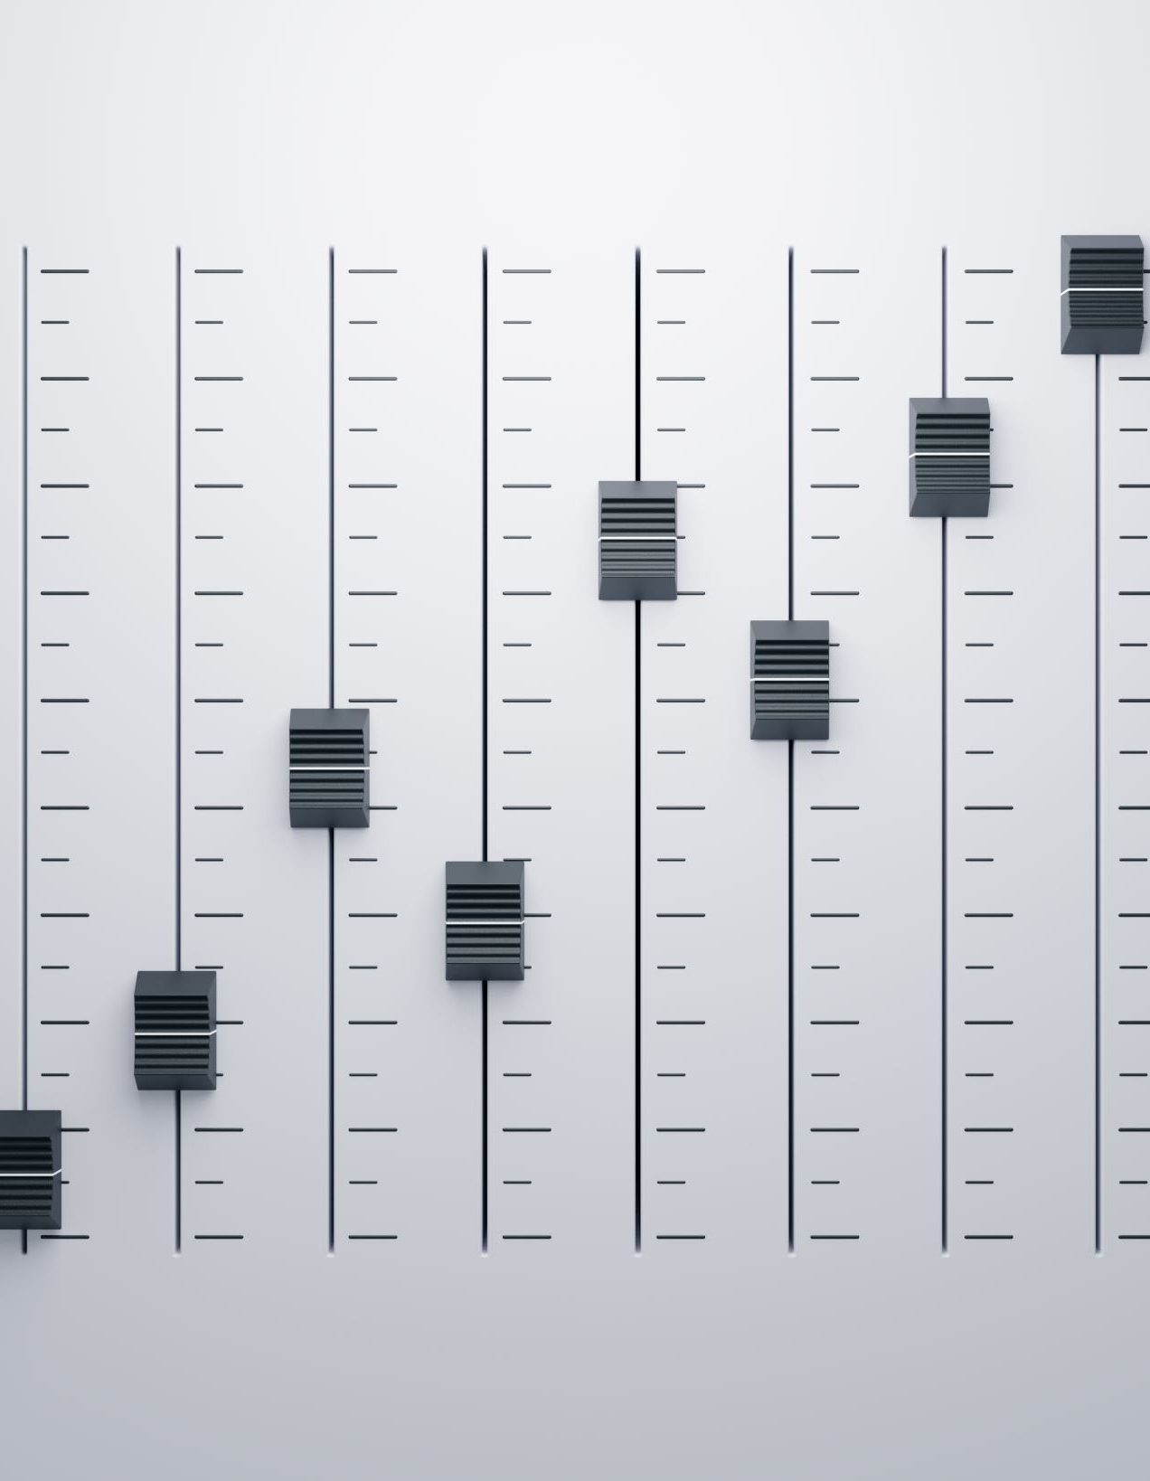
Concept aspects
Variable Parameters for the User Interface
Time Controls
Simulation speed & time step resolution
Object Properties
Mass, size, shape, material characteristics, and applied forces
Environmental Settings
Gravity, air resistance, and boundary conditions
Visual Options
Graphical overlays, zoom, pan, and grid/scale adjustments
Interaction Controls
Intuitive drag-and-drop tools for building and modifying simulations

Slide 6
Project Ideas
Project Ideas | Description
Sunny, Quantum Physics | Simulate different quantum phenomena
Kevin | A 2D all-in-one physics engine
Raiven | 2D solar system simulator
Vinith, realistic Plinko using kinematics, energy and gravity | A fun minigame that allows users to rack up points while visualizing real-world physics concepts such as collisions and free-fall motion.
2D physics simulator | Simple but can add a lot of feature

Slide 7
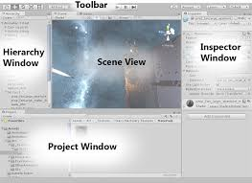
I/O (very easy)
Create preset
Drag preset to scene
Simulate
(Optional) Make modifications
(You can start anywhere)

Slide 8
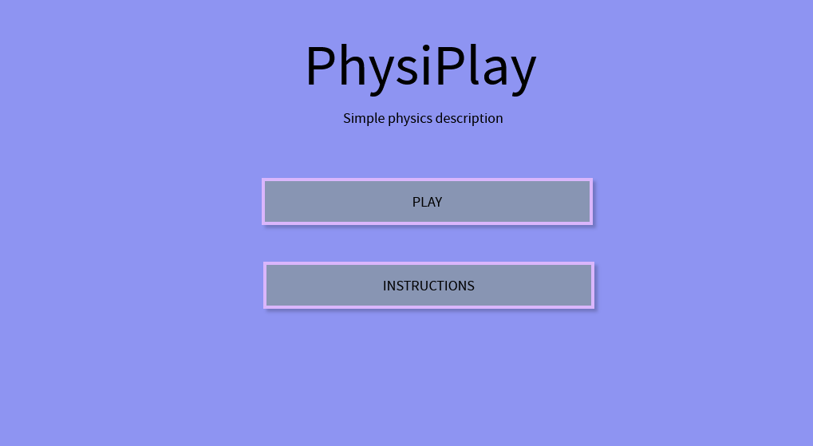
Mockup (main menu)
Optional: Add background image

Slide 9
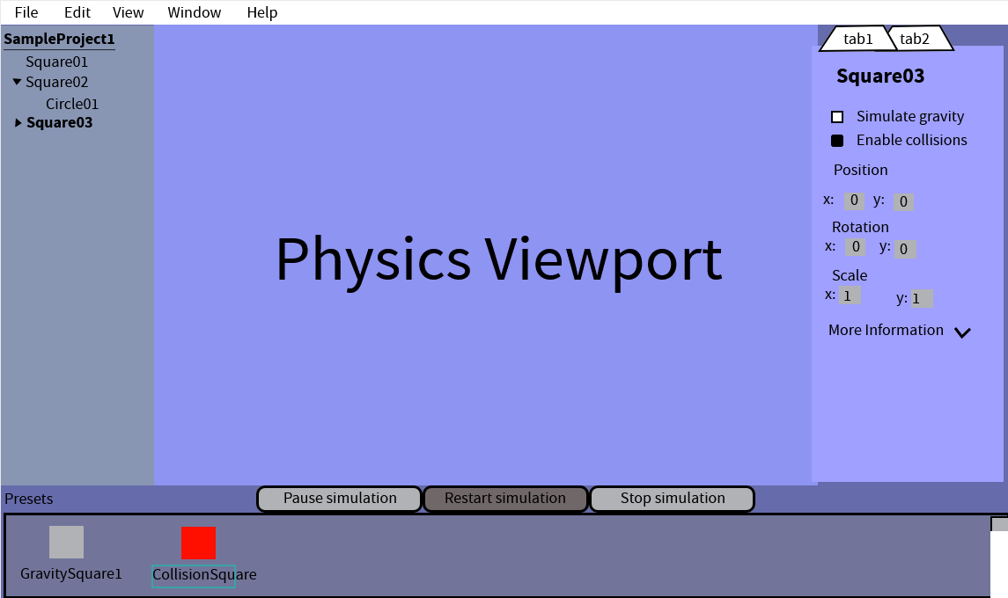
Mockup (game scene)

Slide 10
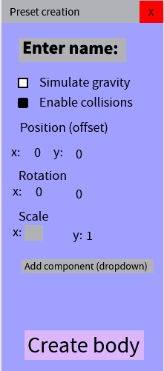
Mockup (object creation wizard)
Preset creation window
Add components (renderer [what shape?], physics, audio, etc.)
Friendly UI

Slide 11
Feasibility
Canvas
JavaFX shapes
Drag and drop (Mouse Event)
Dragboard
AnimationTimer
Canvas and shapes (Less than a month)
Drag and drop (less than a month)
AnimationTimer (About a month)

Slide 12
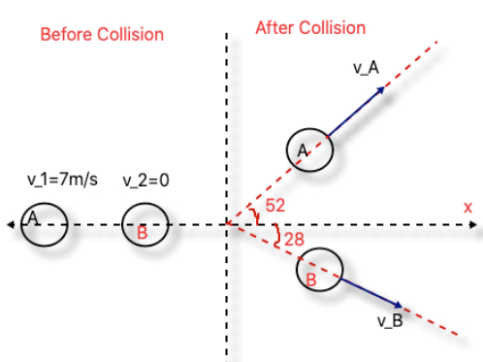
Science Concept 1
Momentum Transfer: When a faster-moving ball collides with a slower one, its velocity transfers to the slower ball, while the originally fast ball slows down. This follows the principle of conservation of momentum.
Conservation of Energy: The total kinetic energy of the system remains nearly constant (assuming minimal friction), allowing the motion to continue smoothly, similar to air hockey or billiard collisions.

Slide 13
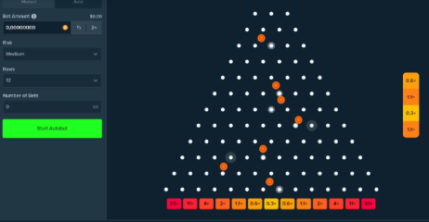
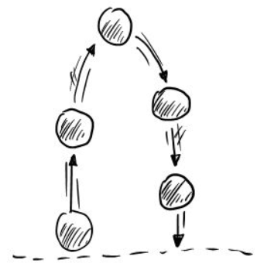
Science Concept 2
Kinematics: Describes the motion of the ball as it falls and bounces off pegs, using equations of motion.
Free Fall: The ball accelerates downward due to gravity (variable)

Slide 14
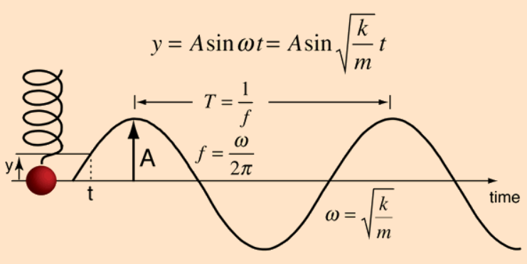
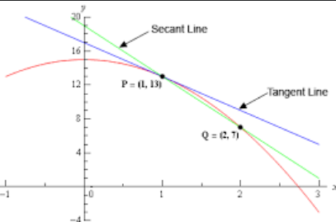
Science Concept 3
Simple Harmonic Motion (SHM): When an object is attached to the spring and displaced from its equilibrium position, it will undergo SHM, where the restoring force causes it to oscillate back and forth.
Calculus I : Derivatives to get velocity and acceleration formulas

Slide 15
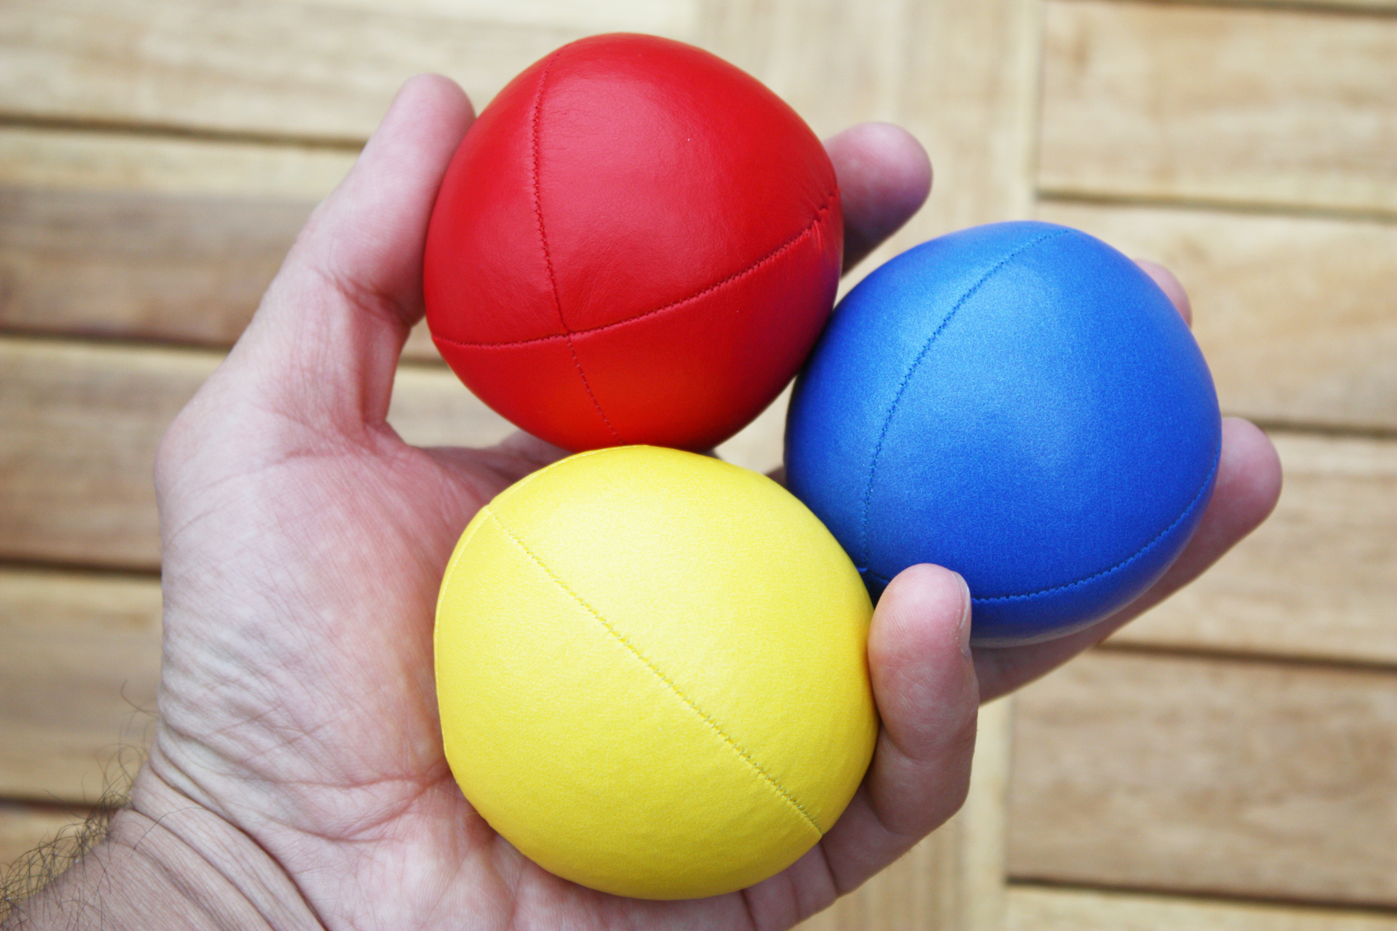
Individual Parts (Sunny)
Ball collisions
Momentum
UI and CSS
Any new physics feature

Slide 16
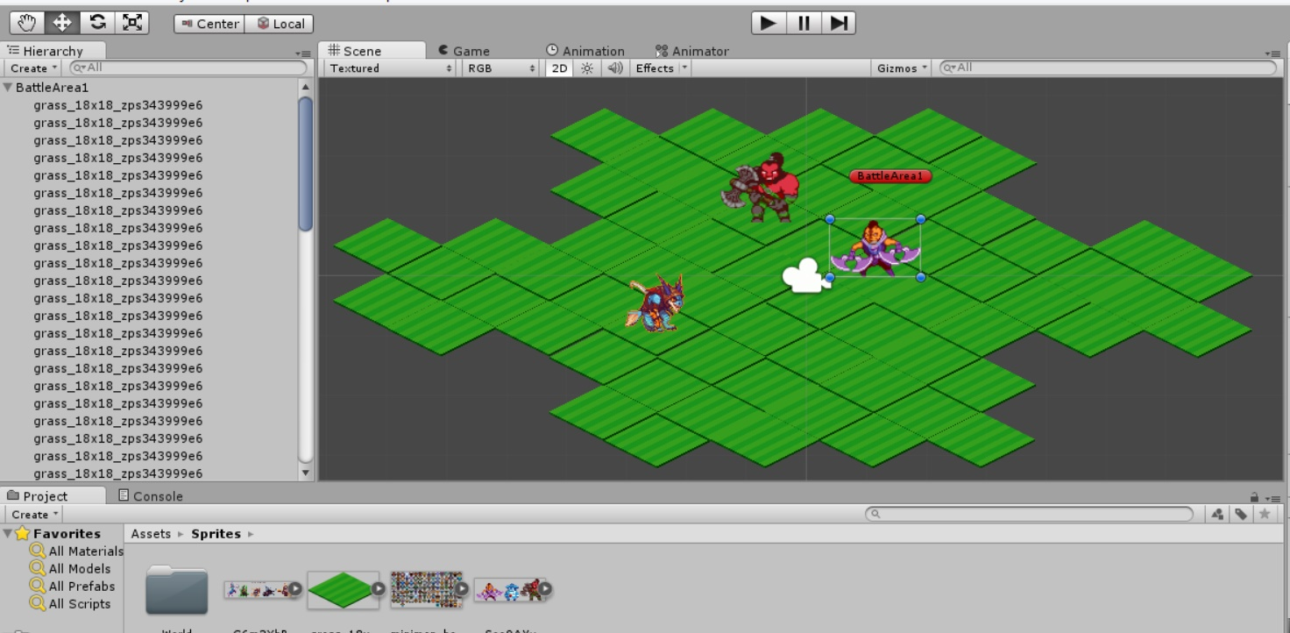
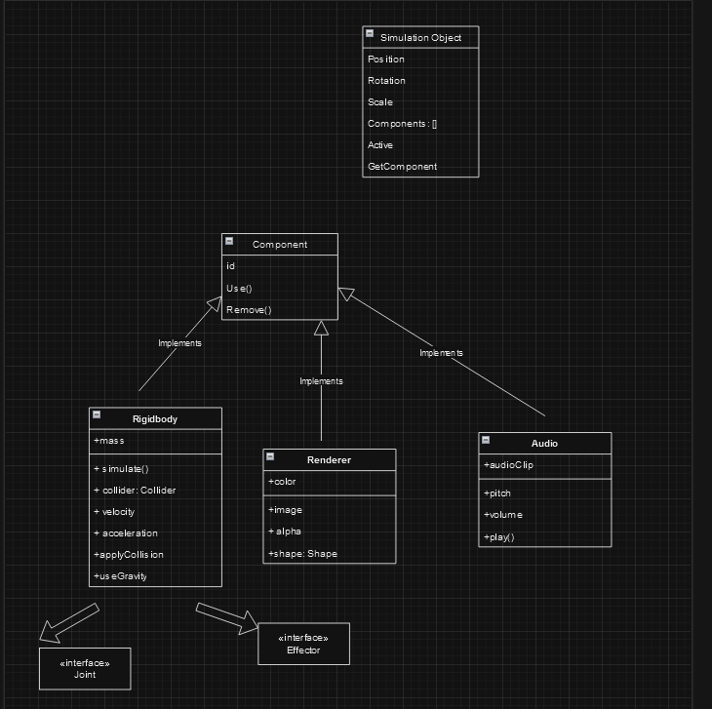
Individual Parts (Kevin)
Object structure implementation
Drag-and-drop mechanic
Preset creator window
Extreme programming + code review
Note: This is a VERY simplified UML diagram
ThePhoto by PhotoAuthor is licensed under CCYYSA.

Slide 17
Individual Parts (Vinith)
Projectile motion with kinematics formula
Implementation of simple harmonic motion with user customization
Graphs that display parameters in real time to visualize

Slide 18
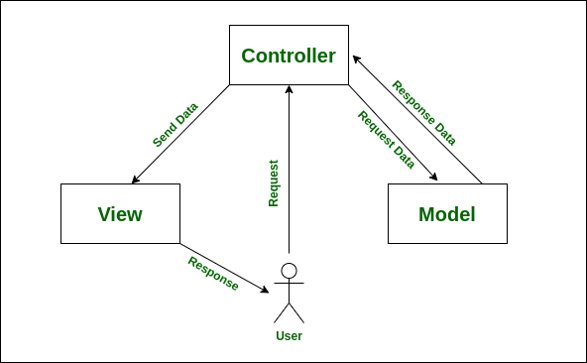
Individual Parts (Raiven)
Asset Management System Design – stuff like saving/loading assets and scenarios
Process Coordination and Best Practices – making sure MVC (Model View Controller architecture) principles are maintained and adhered

